Slide 1

Redactable Blockchain in the Permissionless Setting

Slide 2
How does the Traditional Blockchain Work?
A monetary system without relying on central trusted authority
Blocks are created by miners based on specific information(include transaction information, timestamp,the hash value of last block and so on) and specific consensus mechanism(PoW，PoS)
Every block before adding to chain must be accepted by all of miners.
Impossible to remove any data (addresses, transaction values, timestamp information) that has stabilised in the chain

Slide 3
How does the Traditional Blockchain Work?

Slide 4
But, is it perfect?
Since permissionless blockchains are completely decentralised and allow for any user to post transactions to the chain for a small fee, MALICIOUS USERS can post transactions to the system containing ILLEGAL AND/OR HARMFUL DATA, such as (child) pornography, private information or stolen private keys, etc.
不敢配图

Slide 5

How to deal with this problem?
REDACTABLE BLOCKCHAIN !
Give blockchain a chance to weed out illegal information !

Slide 6
Introduction of the Redactable Blockchain
The edit operations can be proposed by any user and they are voted in the blockchain through consensus. The edits are only performed if approved by the blockchain policy (e.g., voted by the majority).
The protocol is based on a PoW consensus, however, it can be easily adapted to any consensus mechanism, since the core ideas are inherently independent of the type of consensus used.
The protocol also offers accountability for edit operations, where any edit in the chain can be publicly veriﬁed.

Slide 7
How does Redactable Blockchain work?
A user ﬁrst proposes an edit request to the system. The request consists of the index of the block he wants to edit, and a candidate block to replace it.
Request
Request
Request
Request

Slide 8
How does Redactable Blockchain work?
1
When miners in the network receives an edit request, they ﬁrst validate the candidate block using its old state information and verifying the following conditions: (1) it contains the correct information about the previous block, (2) it has solved the proof of work (3) it does not invalidate the next block in the chain. If the candidate block is valid, miners can vote for it during the request’s voting period by simply including the hash of the request in the next block they mine. The collision resistance property of the hash function ensures that a vote for an edit request cannot be considered as a vote for any other edit request.
Notice that the original information has CHANGED
Notice that the old state information has NOT CHANGED

Slide 9
How does Redactable Blockchain work?
1
When miners in the network receives an edit request, they ﬁrst validate the candidate block using its old state information and verifying the following conditions: (1) it contains the correct information about the previous block, (2) it has solved the proof of work (3) it does not invalidate the next block in the chain. If the candidate block is valid, miners can vote for it during the request’s voting period by simply including the hash of the request in the next block they mine. The collision resistance property of the hash function ensures that a vote for an edit request cannot be considered as a vote for any other edit request.

Slide 10
How does Redactable Blockchain work?
1
2
After the voting period for a request is over, everyone in the network can verify if the edit request was approved in accordance to the policy (e.g., by checking the number of votes it received). If the request was approved, then the edit operation is performed by replacing the original block with the candidate block.

Slide 11
The blocks of Redactable Blockchain
WHAT is old state???
Block of Immutable Blockchain
Blocks of Redactable Blockchain

Slide 12
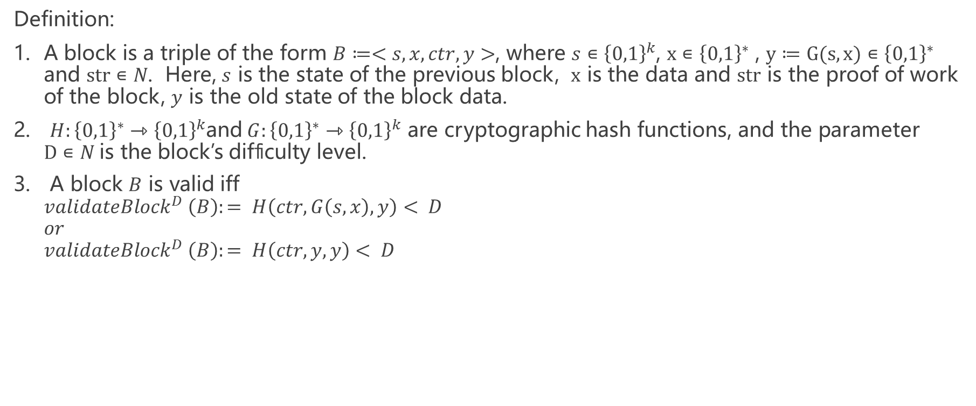
The Protocal of Redactable Blockchain
Definition:
A block is a triple of the form $B≔<s,x,ctr,y>$, where $s∊{\left\{0,1\right\}}^{k}$, $x∊{\left\{0,1\right\}}^{∗}$ , $y≔G(s,x)∊{\left\{0,1\right\}}^{∗}$ and $str∊N$. Here, $s$ is the state of the previous block, $x$ is the data and $str$ is the proof of work of the block, $y$ is the old state of the block data.
$H:{\left\{0,1\right\}}^{∗}{⇾\left\{0,1\right\}}^{k}$and$G:{\left\{0,1\right\}}^{∗}{⇾\left\{0,1\right\}}^{k}$ are cryptographic hash functions, and the parameter $D∊N$is the block’s difﬁculty level.
A block $B$ is valid iff ${validateBlock}^{D} \left(B\right):= H\left(ctr,G\left(s,x\right),y\right)< D$ $or$ ${validateBlock}^{D} \left(B\right):= H\left(ctr,y,y\right)< D$

Slide 13
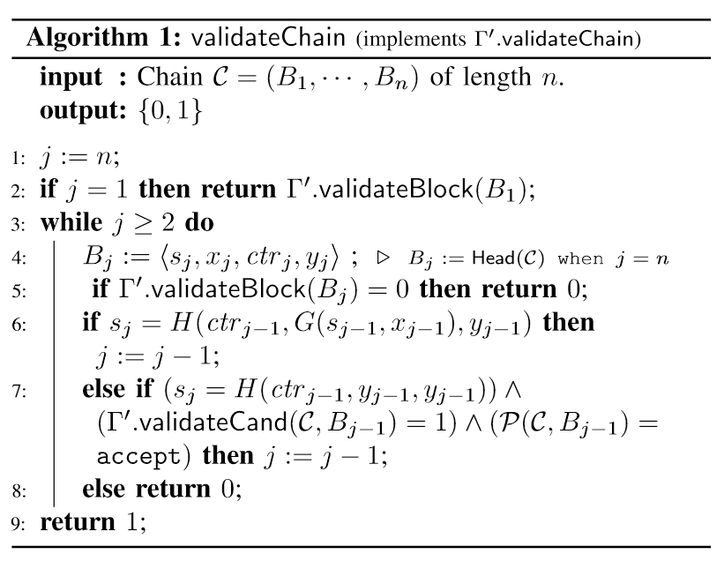
The Protocal of Redactable Blockchain
Algorithm:

Slide 14
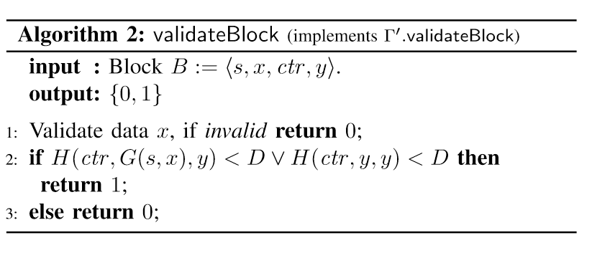
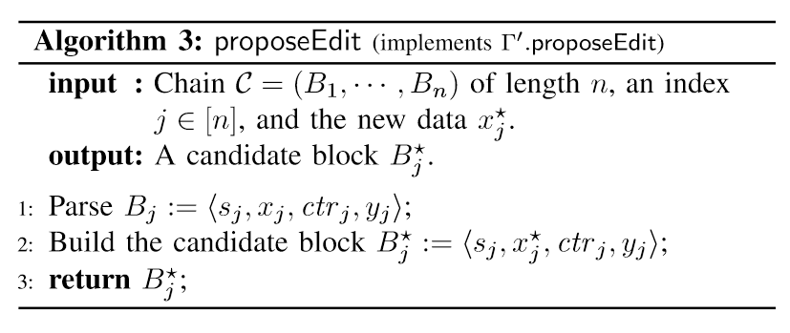
The Protocal of Redactable Blockchain
Algorithm:

Slide 15
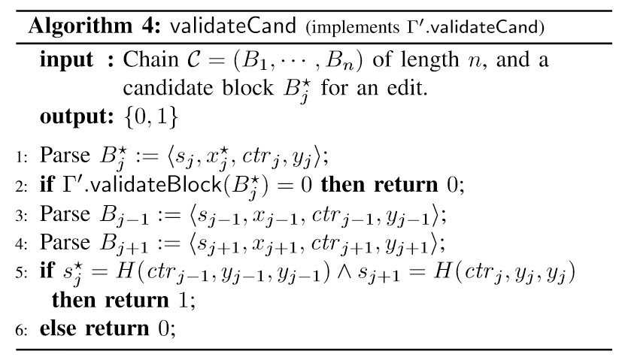
The Protocal of Redactable Blockchain
Algorithm:

